Slide 1
AI-based VR Conversation Demo
By TheVoice

Slide 2

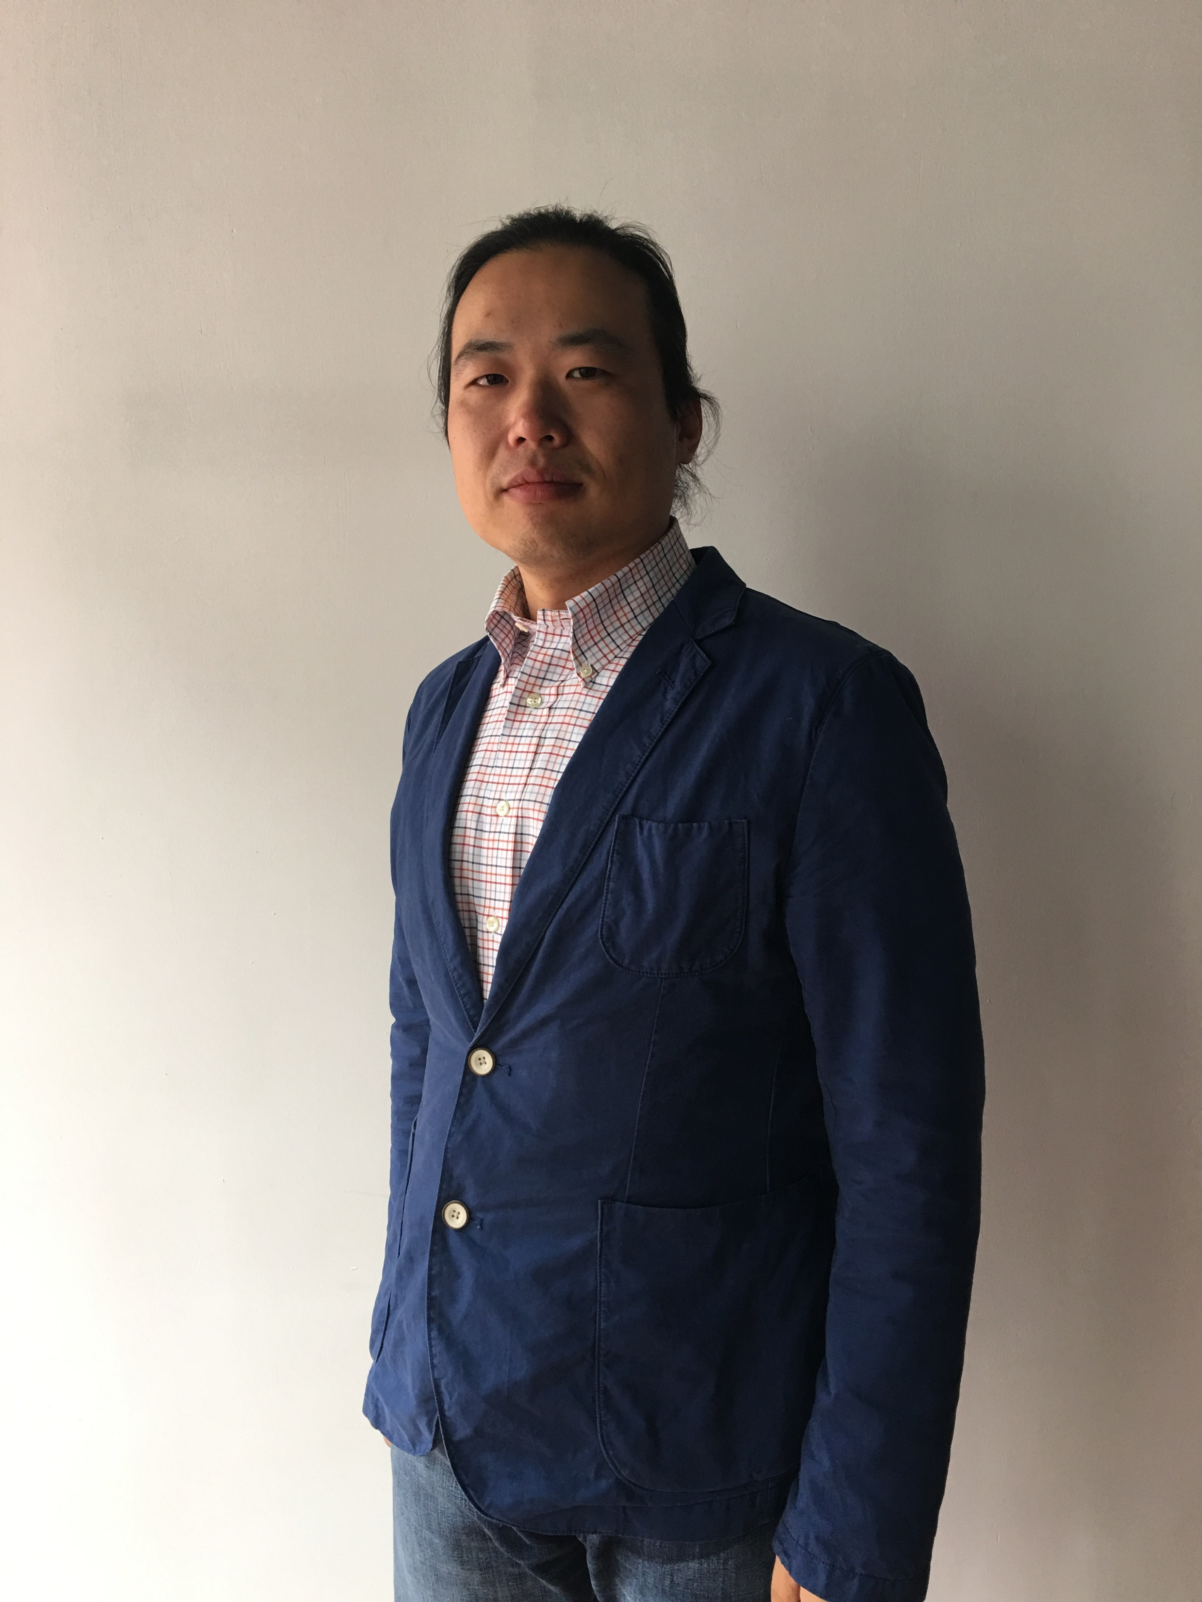
Team TheVoice
Shuo Pang
Korhan Akcura

Slide 3
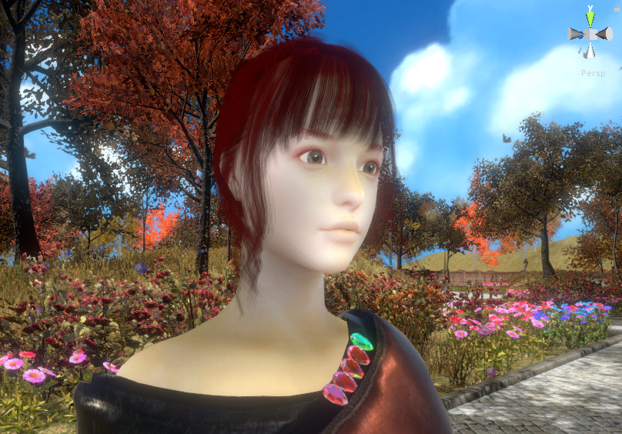
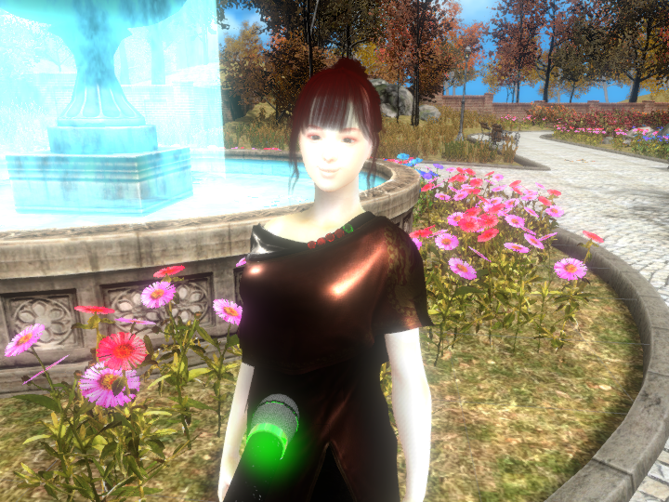
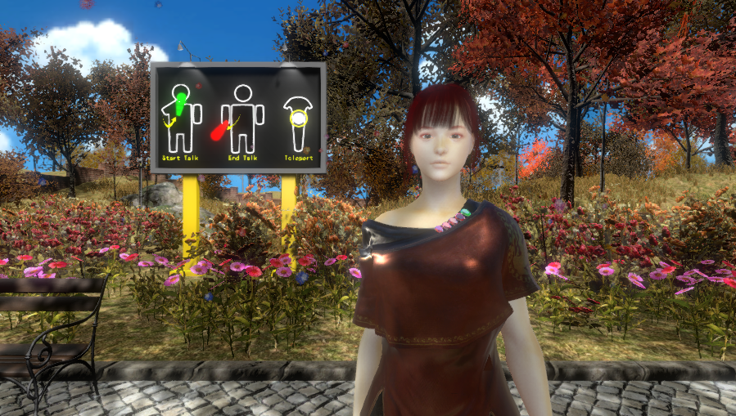
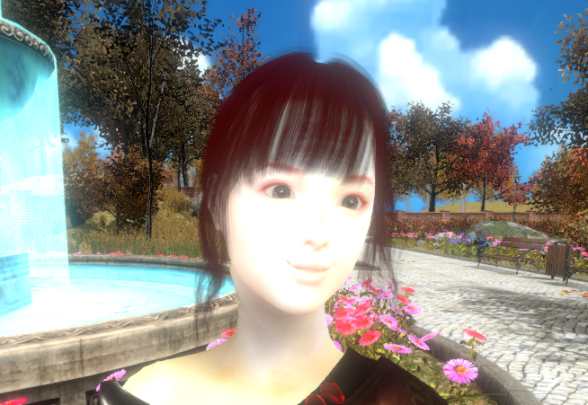
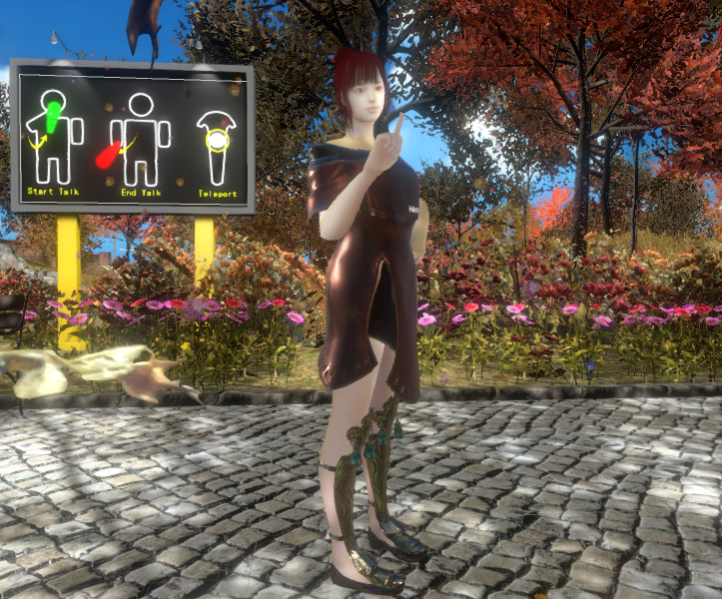
What’s the features?
AI-based Conversation Model
VR Immersive Experience
Natural Interaction
Emotion Analyzing
High Quality Rendering

Slide 4
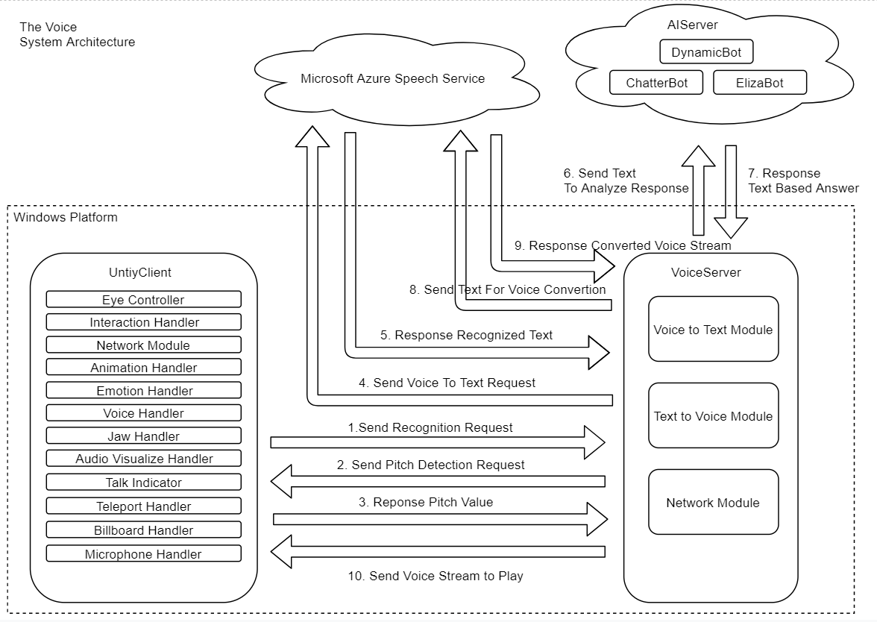

Slide 5
Thanks For Watching!
Contact: pangshuo1981@gmail.com

